Slide 1
OGEC Architecture Academy
Adobe Experience Manager– Deep Dive
Steve Cherneff

Slide 2
Overview/History
Demos
Architecture
Integragtions

Slide 3

















Adobe Experience Manager
Modern cloud application that accelerates creation, management and delivery of personalized experiences across any touchpoint
Source | Create
Manage | Assemble
Personalize | Deliver
Ingest any number of content types: Creative Cloud, Stock, Brand Assets and more
Easily store, find and compose varied experiences
Intelligent personalization and channel-agnostic content delivery
Dynamic Forms & Docs
Adobe Experience Manager
Connected Screens
Social Media
Web & Mobile Site
Email
Email
Mobile Apps
Single
Page App
Single
Page App
IoT Apps
Smart Content Services
Powered by Adobe Sensei
Artificial Intelligence & Machine Learning

Slide 4




Adobe Experience Manager
Adobe Experience Manager
Sites
Assets
Forms
Screens
Easily compose and deliver digital experiences across online & physical touch points
Digital asset creation, management and delivery
Multi-channel forms, onboarding, and customer communications management
Deliver dynamic
and interactive digital experiences into physical places
Experience Intelligence
Powered by Adobe Sensei
Open & extensible APIs

Slide 5
Day Software

Slide 6


Re-architecting Web Content Management
Founders
Roy
D
David
Web
Content

Slide 7
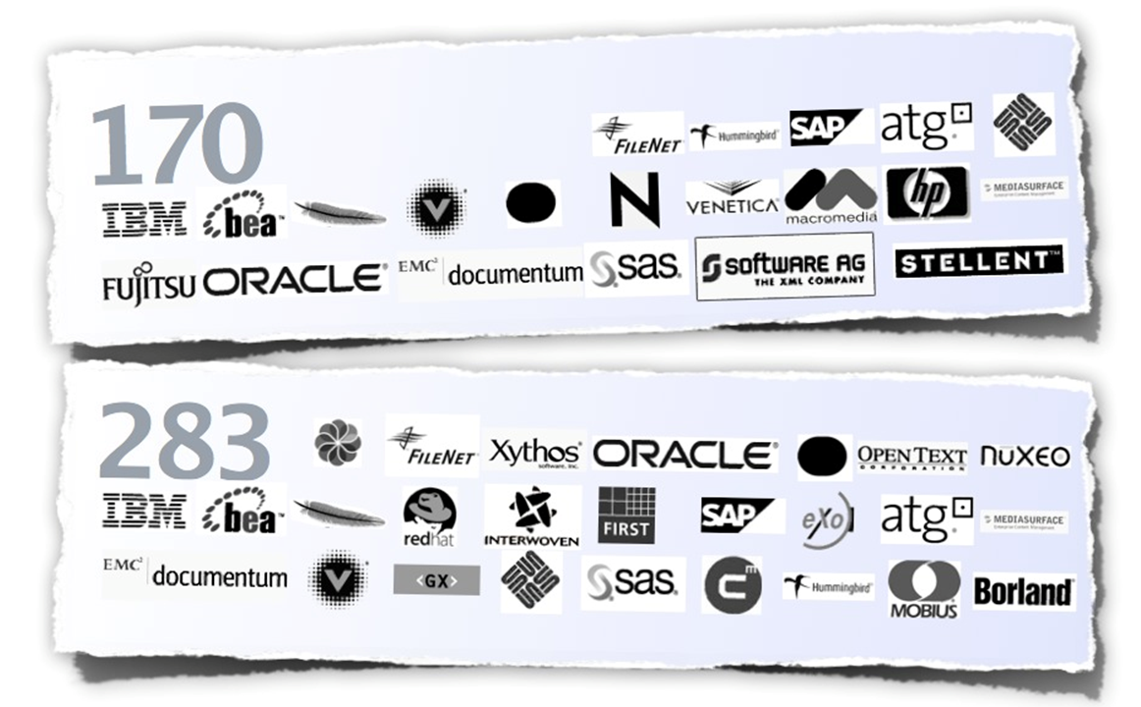
Content Standards
Content Repository

Slide 8
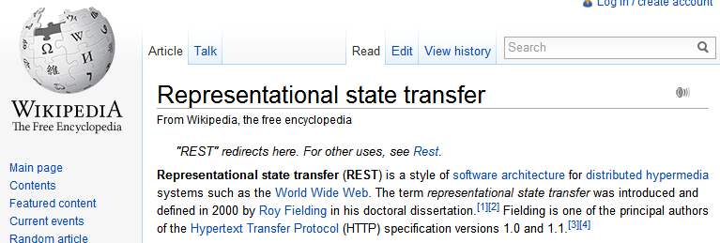
Web Standards
REST

Slide 9
Open Agile Modern Standard

Slide 10
Adobe Experience Manager
Adobe Experience Manager
Sites
Assets
Forms
Screens
Easily compose and deliver digital experiences across online & physical touch points
Digital asset creation, management and delivery
Multi-channel forms, onboarding, and customer communications management
Deliver dynamic
and interactive digital experiences into physical places
Experience Intelligence
Powered by Adobe Sensei
Open & extensible APIs

Slide 11
Demo

Slide 12
Architecture

Slide 13




AEM Platform – Core Components
Interacting with any client runtime
HTTP[S], JSON, WebDAV, XML
Web Application Framework
Fully OSGi/Java based modern Application Stack
Extensible and Modular
Application Runtime
User Management
Plugable Authentication w/ JAAS and LDAP
Access Control, Versioning, Search, Observation
Various Persistence Options – TAR files, MongoDB, Relational Database, S3
JCR Content Repository
Java VM
Running Standalone or Java EE Application Server
Notes:
A simplified view of what is part the AEM platform.
As base the JCR 2.0 compliant Content Repository.
Then the OSGi runtime to host Java applications with access to repository via JCR API
In the runtime we ship a web application framework that is exposing the full repository content via HTTP and other protocols
All of these pieces are based on Apache projects – Jackrabbit, Felix, and Sling and Adobe contributes heavily to each of these projects. Jackrabbit and Sling were listed in eWeek’s 11 Apache Technologies that have changed computing in the last 10 years.
AEM can run standalone using an embedded servlet engine – therefore the only requirement to run is the Java VM. AEM can also be installed into a Java EE application server

Slide 14
Content Repository
Transactions
Query
Structure
Integrity
Binaries
Hierarchy
Locking
Access Control
RDBMS Features
File System Features
Standardized
API
Multi-Value Properties
Unstructured
Ordering
Full Text
Versioning
Observation
Other Good Stuff

Slide 15

Instance Types – Building Blocks
Author
Publish
Approved Content
Adobe Experience Manager
Adobe Experience Manager
JCR
JCR
Dispatcher
Dispatcher
HTTP(S)
HTTP(S)
Authors, Editors, Approvers
End Users
Notes:
There are a few key building blocks to an AEM deployment. The first instance type is used by content authors, editors, and approvers to create and review content. When content is approved, it is published to a second instance type from which it is accessed by end users.
We refer to the first instance type as an author instance and the second instance type as a publish.
There’s also a separate piece of infrastructure here called the Dispatcher. This is a module installed in your web servers which handles caching and URL filtering.

Slide 16

Example Physical Layout / Deployment
Web Server
Dispatcher
Firewall
Adobe Experience Manager
Publish
Adobe Experience Manager
Author
Web Server
Dispatcher
Dispatcher
Adobe Experience Manager
Publish
Firewall
Enterprise Systems
LDAP
RDMBS
ERP
CRM
ECM

Slide 17

Dispatcher
Content Retrieval
Web Server
(Apache 2.2, 2.4, IIS 7.5, 8.x, or iPlanet)
Adobe Experience Manager
Dispatcher Module
Cache Invalidation
JCR
Disk Cache
Notes:
The dispatcher is a web server module for Apache, IIS, or iPlanet which provides caching and security services. It uses a disk based cache.

Slide 18








AEM Enterprise Architecture
Input
Manage / Automate
Delivery
Asset Link
Workfront
Adobe Stock
Creative Cloud
Brand Portal
AEM UI
Dynamic Media
AEM Desktop App
AEM
3rd-party Integrations
Asset Selector
Content
Adobe IMS
HTTP API
Author
Author
Sites
CDN
Asset Share
Tagging
Custom Metadata Schemas
Workflow
Publisher
Dispatcher
Headless
(GraphQL/Content Fragments)
HTTP API
Publisher
Dispatcher
Custom Components
Content Automation
PS/LR API
External Connection
Assets Compute Service
3rd-party Integrations

Slide 19
Containerization
Per Environment
Shared Service
Containers
CDN Service
Orchestration Service
Content Repository Service
Replication Service
(Adobe Pipeline)
Publish Tier
AEM Sites
Nodes (Publish)
Dispatcher
Dispatcher
Publisher
Publisher
Nodes (Author)
CI/CD Service
Blobs (Shared)
Author Tier
AEM Sites/Assets
Author
Author
Author
Assets Compute Service
(Adobe I/O Runtime)
Identity Management Service
Maintenance
Job
Job
Testing Service
(Adobe I/O Runtime)

Slide 20
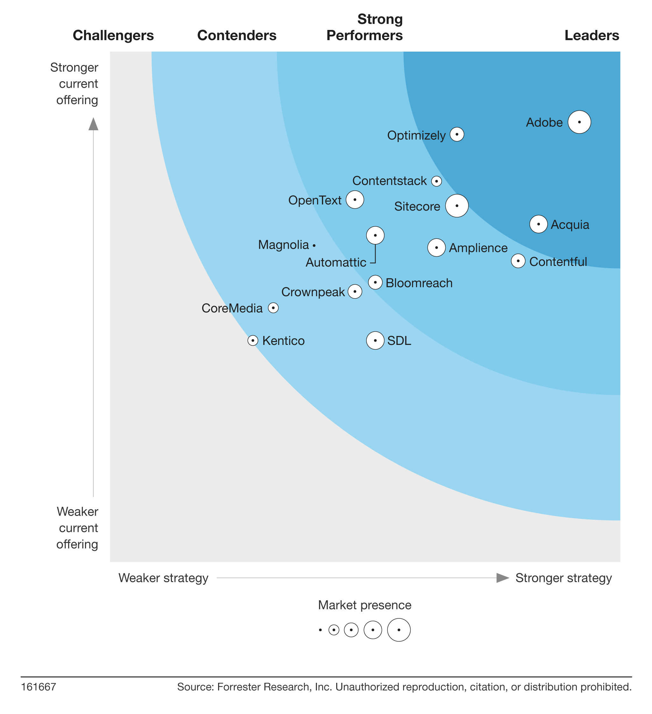
Forrester Wave for Agile Content Management Systems, 2021
Adobe received the highest score of all participating vendors for both “current offering” and for “strategy”
Strengths noted:
Strong vision and solid community and collaboration capabilities
Personalization and metadata capabilities bolstered by AI
Powerful ecosystem due to suite of technologies, including creative, analytics, and commerce
Highest scores* for the following:
Community and market approach
Content Services
Vision
* Based on scores published in Forrester’s Agile CMS Wave 2021 Scorecards (on scale of 1-5)

Slide 21
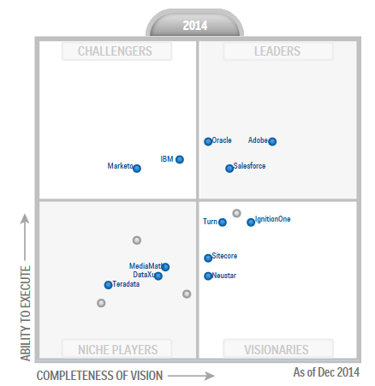
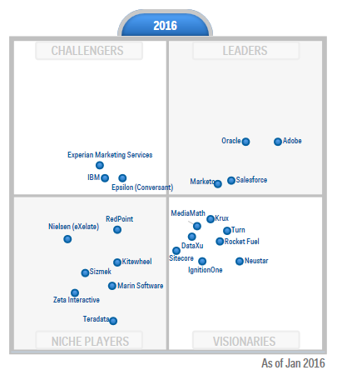
Growing Leadership Position in Gartner Digital Marketing Hubs

